Slide 1
Check-In Kiosk Security

Slide 2
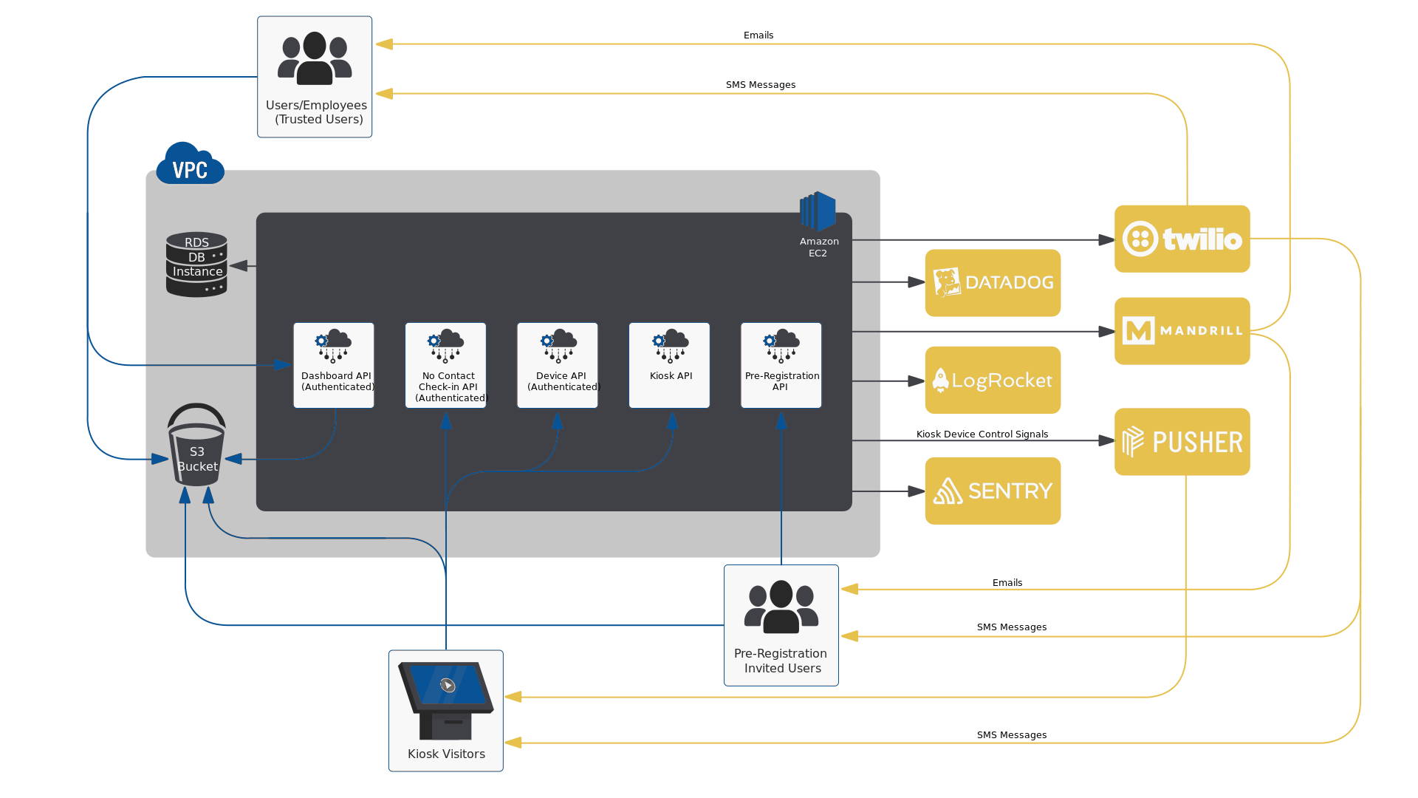
Check-In Kiosk Data Flow Diagram

Slide 3
Infrastructure & Data Storage
Our infrastructure is 100% cloud-based and provided by AWS. This affords us the ability to leverage the security and reliability of the world’s largest cloud provider.

Slide 4
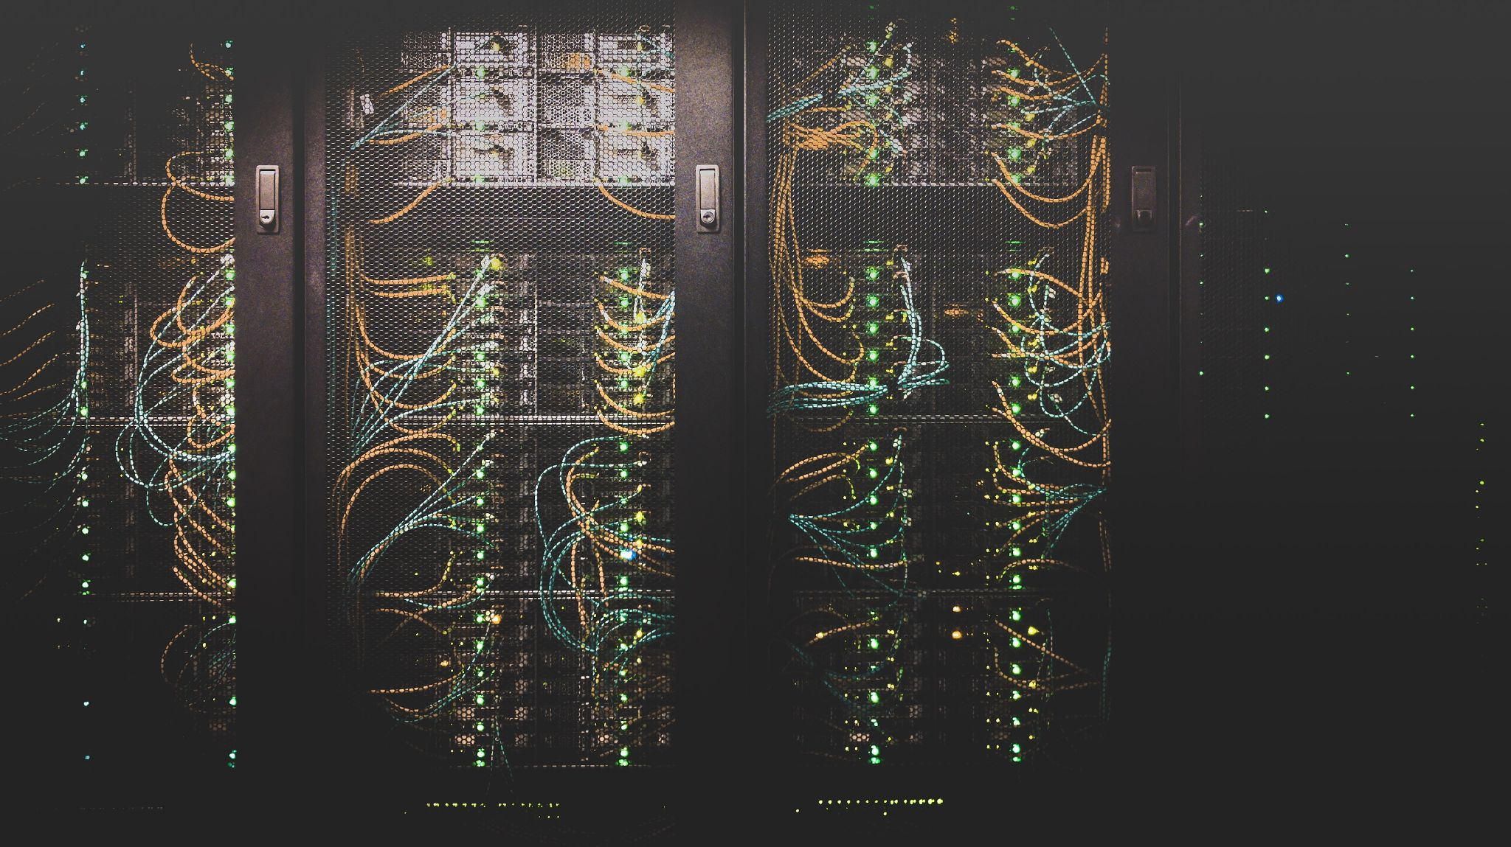
Where is data stored? What data is stored?
Data Storage
Data is stored in our database and S3 buckets which are both located in the AWS US-East-2 data center. There, all data is encrypted at rest with AES-256 as well as during transit to and from with TLS v1.2 and above.
Data stored are:
Presentation configuration data
Images
Videos
Spreadsheet data
No sensitive customer data is stored.

Slide 5
Backups
Backups occur daily and are retained for 7 days. Backups are fully encrypted with AES-256 and stored securely off-site in the AWS US-East-2 data center.
Data Retention
Data is stored indefinitely, however in compliance with GDPR, CCPA and PIPEDA guidelines our customers have the right to request its removal at any time which we will do promptly.
Application Access Control
As part of our best practice security protocols, we conduct regular access control audits on our infrastructure as well as the web application itself.
Access to the presentation data and interface is limited to internal employees and accounts are fully secured. Application audit logs are kept and monitored to ensure security.

Slide 6
Infrastructure Access Control
Our infrastructure is secured using best practice security processes and controls including:
Multi-factor authentication
Audit logs
Firewalls
Access control lists
Password policies
Breach detection tools
Only top-level individuals on our development team are granted access to our database and servers and only under special circumstances such as diagnosing a problem, gathering data or for maintenance.
Our support team is allowed remote access to a device to help diagnose technical difficulties our customers report. Support team members will only access a device if a problem has been reported there. The connection is fully encrypted and all devices are secured with password protections.

Slide 7
Organizational Security
We do our best to follow best security practices at the organizational level as well as the technical level. For this reason we have implemented to following organizational controls:
Acceptable Use Policies
Disaster Recovery Plans
Password Policies
Access Reviews
Incident Response Plans
Secure Premises
Business Continuity Plans
Non-Disclosure Agreements
Surveillance
Supervision
Vendor Assessments
Third Party Integrations
Pusher: used to send real-time events to devices
Sentry: used to track bugs and error logs in real-time
Datadog: used for infrastructure monitoring

Slide 8
Real-time Security & Threat Detection
Our application undergoes rigorous multi-stage testing throughout the development cycle to ensure that it is stable and secure. That is just the first layer of security: adhering to safe and responsible coding practices to protect against the most common vulnerabilities modern apps fall prey to such as SQL injection, cross-site scripting and cross-site request forgery attacks. Following testing, all of our code also undergoes a code scan upon submission by our developers to ensure that the additions to the application have not introduced any new security vulnerabilities.
The next layer is our real-time monitoring suite which includes tools such as DataDog and Sentry. The suite allows us to do everything from discovering a bug which has appeared at a single device to investigating unusual traffic patterns across many locations of an organization. The data from these monitoring tools is regularly reviewed by our development team both for the purposes of improving the code quality and to detect any potential security issues.
The final layer is in the form of automated AI-powered threat detection which monitors our infrastructure and application 24/7. This threat detection tool uses data aggregated from around the globe to identify the patterns of malicious activity and notify our developers as soon as it finds something.

Slide 9
Data Privacy Compliance
Currently we are compliant with CCPA in the United States and are in the process of becoming compliant with GDPR in the EU and PIPEDA in Canada.
Reliability & Uptime
Our application is built with the most reliable infrastructure that cloud computing has to offer and our goal is to ensure our customers have 24/7 access to their devices no matter where they are in the world.
Network Load
Image and video assets contained in the presentations are cached to minimize the amount of bandwidth required for a device to operate. Outside of the upfront bundle required to load the presentation only very small requests of a couple kilobytes every 5 minutes are sent to keep the device in sync without database and server.

Slide 10
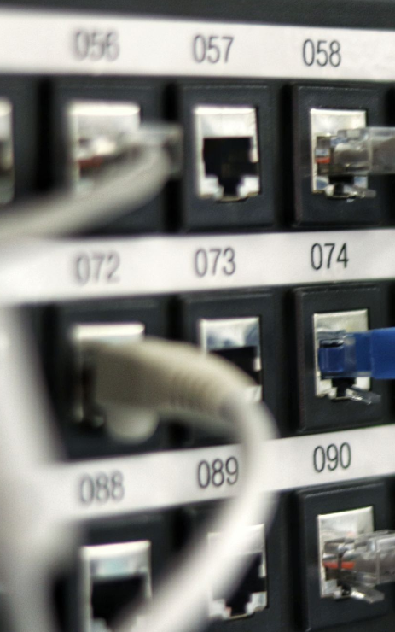
Network Requirements
Only HTTP port 80 and HTTPS port 443 will be required. For a more specific list of domains to whitelist in your network firewall see our networking documentation.

