Slide 1
FactoryTV Setup Guide

Slide 2
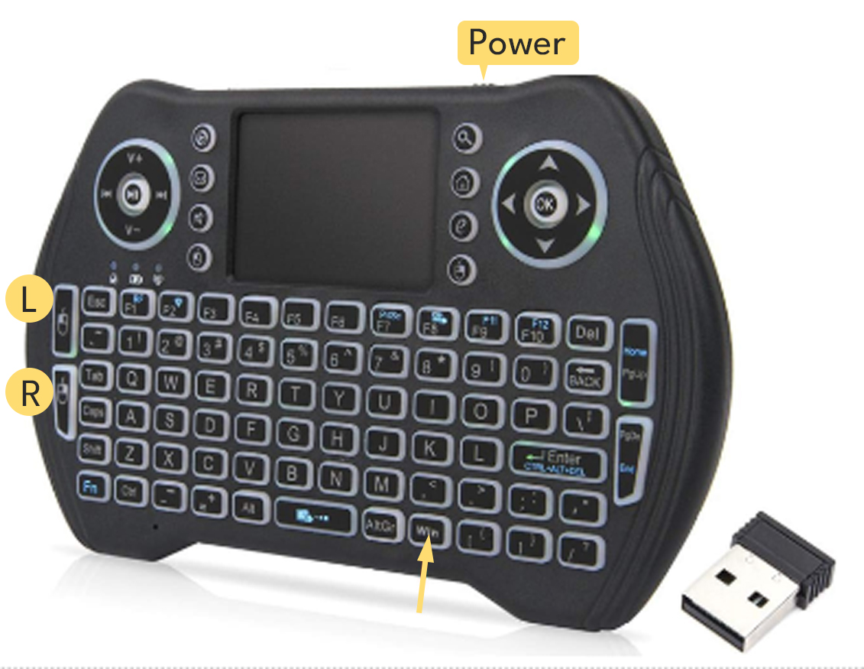
FactoryTV
Setup Guide
Congratulations on the purchase of your Transmission products!
This Minix mini-pc has been preconfigured with your FactoryTV.
If connected directly to a hardwired network jack, it should play automatically. If it doesn’t skip to bottom this guide.
If connecting to your company’s WiFi, use the provided keypad to connect the WiFi.
Remove USB receiver from battery compartment and place in media player.
(not the TV) Cable is for charging only.
Turn the keypad on. Switch on top edge.

Slide 3
FactoryTV
Setup Guide
Press CTRL-SHIFT-Q to stop the program and it should show a Windows desktop background,
with “Call for Support”.
Press the WIN key to unhide the Start button. Use square track pad for the mouse and the buttons on left for Left and Right mouse clicking.
Click on the network icon on far lower right corner of the screen, near the date time to access the WiFi options.
Connect to your company’s WiFi.
Once connected run TransmissionPlayer shortcut on the main screen.

Slide 4
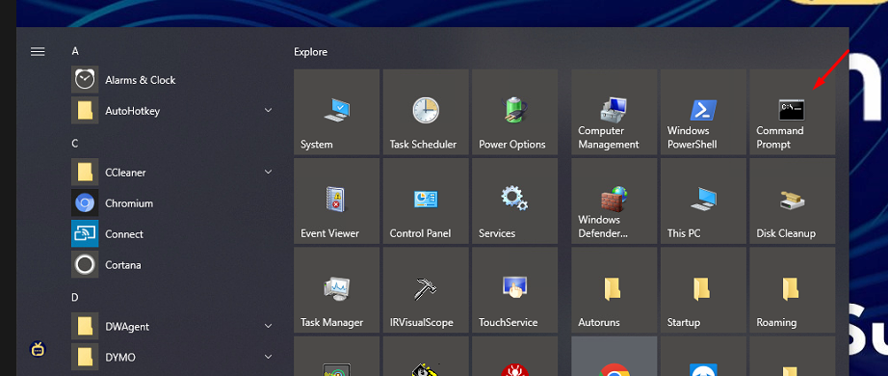
FactoryTV
Setup Guide
If it hardwired and is not playing the FactoryTV there may be a problem with the network jack or a potential firewall issue. Use the same steps above to close the program. Press WIN and select the Command Prompt program.

Slide 5
FactoryTV
Setup Guide
Type IPCONFIG , note the IP addresses and provide them to your IT/Network team, along with the Transmission Network Requirements document.
Connection-specific DNS Suffix . : Eyeconic.tv
Link-local IPv6 Address . . . . . : fe80::80ea:e1d9:addb:572a%13
IPv4 Address. . . . . . . . . . . : 192.168.7.102
Subnet Mask . . . . . . . . . . . : 255.255.255.0
Default Gateway . . . . . . . . . : 192.168.7.1
If you have any questions, call us at 855-622-9369 x2 and Transmission IT staff can assist you.
Thank you for your business!

Slide 6
Check-In Kiosk Setup Guide

Slide 7
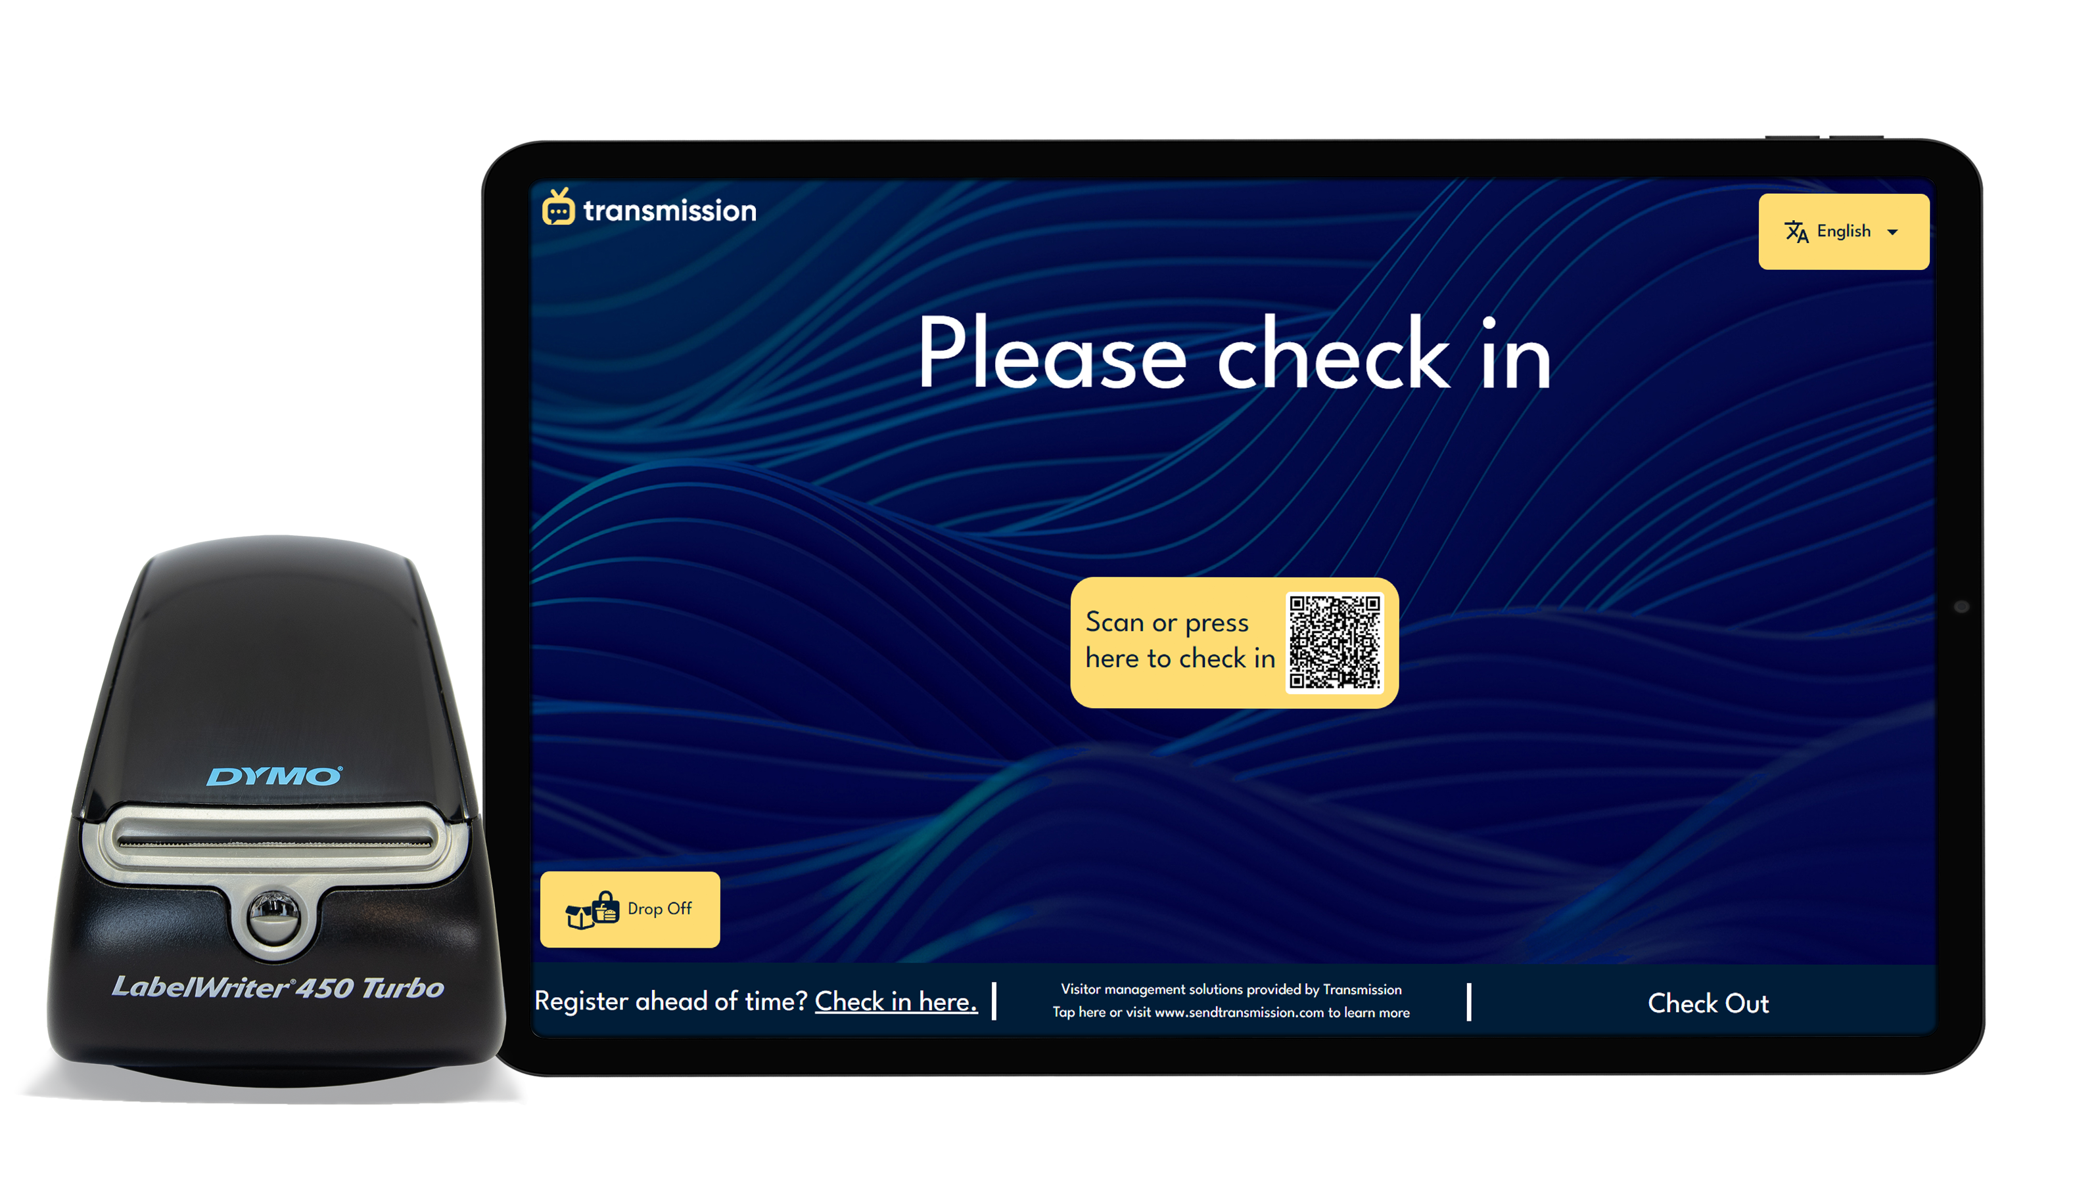
Check-In Kiosk
Setup Guide
Congratulations on the purchase of your Transmission products!
To begin installation, locate where you’d prefer to emplace your check-in kiosk’s media player. The device can be mounted behind the TV to the wall, the TV itself or the mount. Ensure there is easy access to the USB slots for later access.

Slide 8
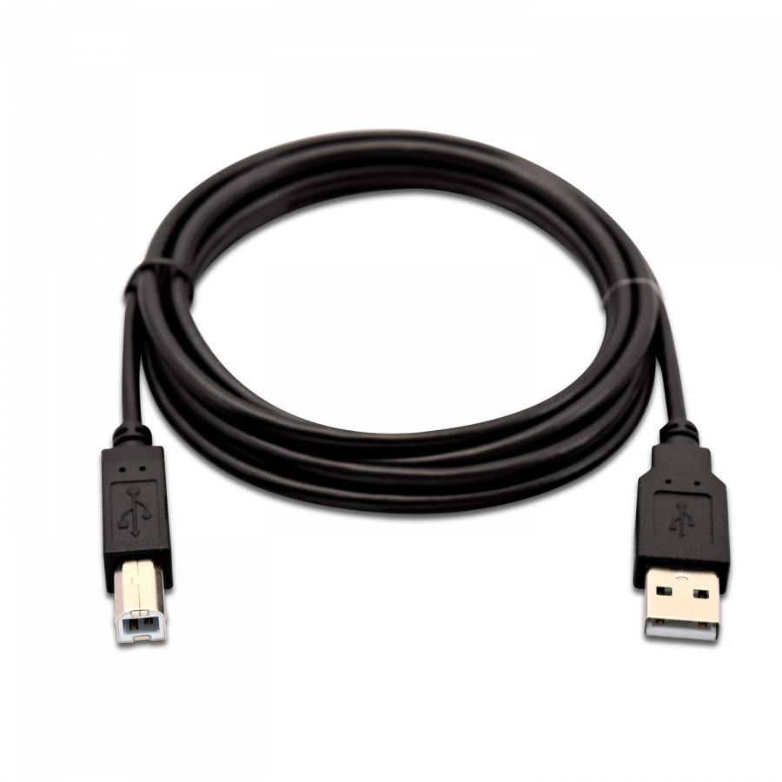
Check-In Kiosk
Setup Guide
Next, look for the following cables:
HDMI to connect the media player to the TV HDMI 1 port.
2 identical USB cables to connect the media player to the label printer and the TV. One of these is for the touch screen function. (There is an image of this cable to the right)
Connect all cables, camera, and WiFi antenna.
Connect an ethernet cable to the media player, or use WiFi.
Connect a keyboard to the media player’s blue USB port (this is temporary).
Turn on the television, label printer, and lastly, the media player.

Slide 9
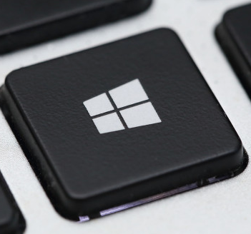
Check-In Kiosk
Setup Guide
The TV should be on HDMI 1 source/input, and you should see a Transmission background with our phone number, and a window for the Transmission app will open prompting you to connect to your internet.
At launch the Transmission app will open and ask you to connect to the internet to complete setup. You can click the "Open Network Settings" button in the window to connect to your preferred WiFi.
Alternatively, you can press Windows key and click on the network icon on the far right corner of the screen near the date/time. Connect to your WiFi.
To test network connectivity, press the Windows key and select the Teamviewer program. If it gives a 9/10 digit number, you’re connected!

Slide 10
Check-In Kiosk
Setup Guide
That’s it, you're done!
Important Note!
Your IT Network Security department may need to know Transmission device(s) will be installed on your network so they can adjust the firewall (our staff can confirm if this is needed). If this is needed:
Using the keyboard, press the Windows key then type CMD and select the Command Prompt option.
Type in IPCONFIG and write down the IPv4 address, send this to your IT.
As always, feel free to call us at 855-622-9369 x2 or email us at support@sendtransmission.com if you encounter any technical difficulties with your system. Thank you for your business!

